Slide 1
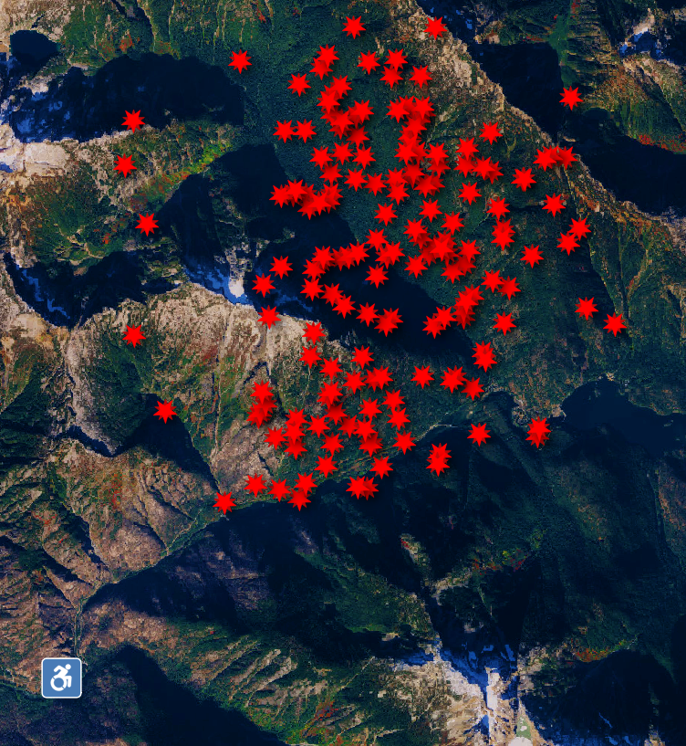
LoLa-LoLa Hazard warnings at the Edge
Low Ability - Low Availability
Challenge: Wildfire Management
Team Stemmies++
Michael Patrick – Concept and Design
Akash Savitala – Computation
Vignesh Srinivasan – Code and Voice
NASA Space Apps 2023 Seattle, Wildfire Management

Slide 2
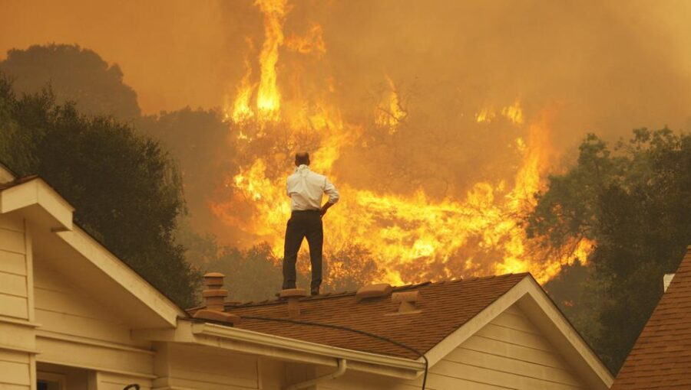
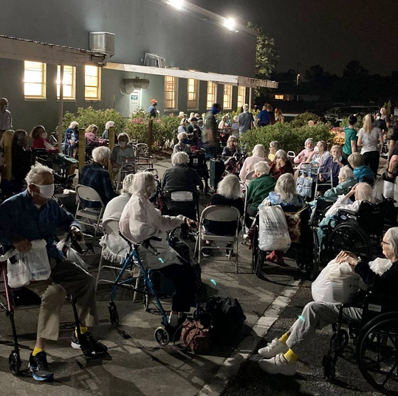
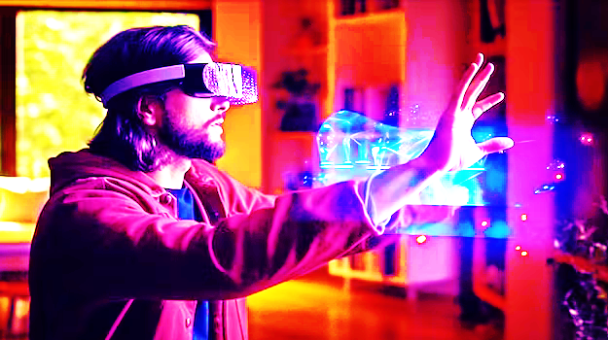
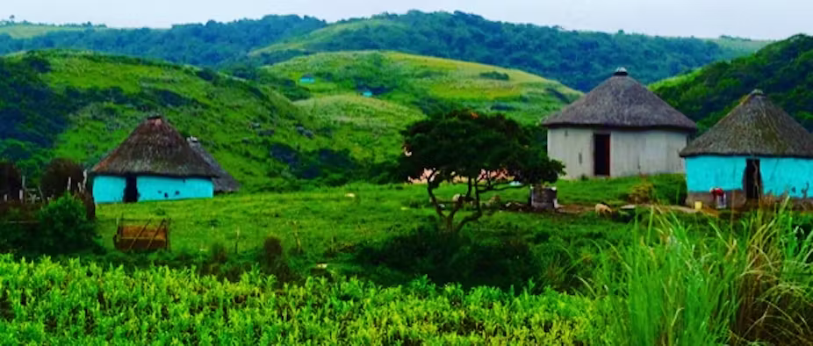
Driving Forces
World is on Fire
Globe is getting Older
High Tech caters to Profit
Rural Communities are Ignored
LoLa-LoLa Hazard warnings at the Edge - Wildfire Management

Slide 3
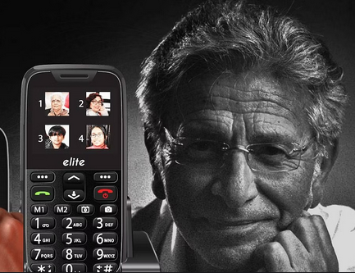

LoLa-LoLa
Constraints
Hazard warnings at the Edge
Low Bandwidths – Cell connections and broadband
Low Ability – Old age disabilities – coordination, vision, and cognition
Low Tech – Feature phones,
Low Availability - Recharging and Coverage
Low Funding
… Low everything!
Target Technology: ‘Feature Phones’ and Voice Mail
NASA Space Apps 2023 Seattle, Wildfire Management

Slide 4
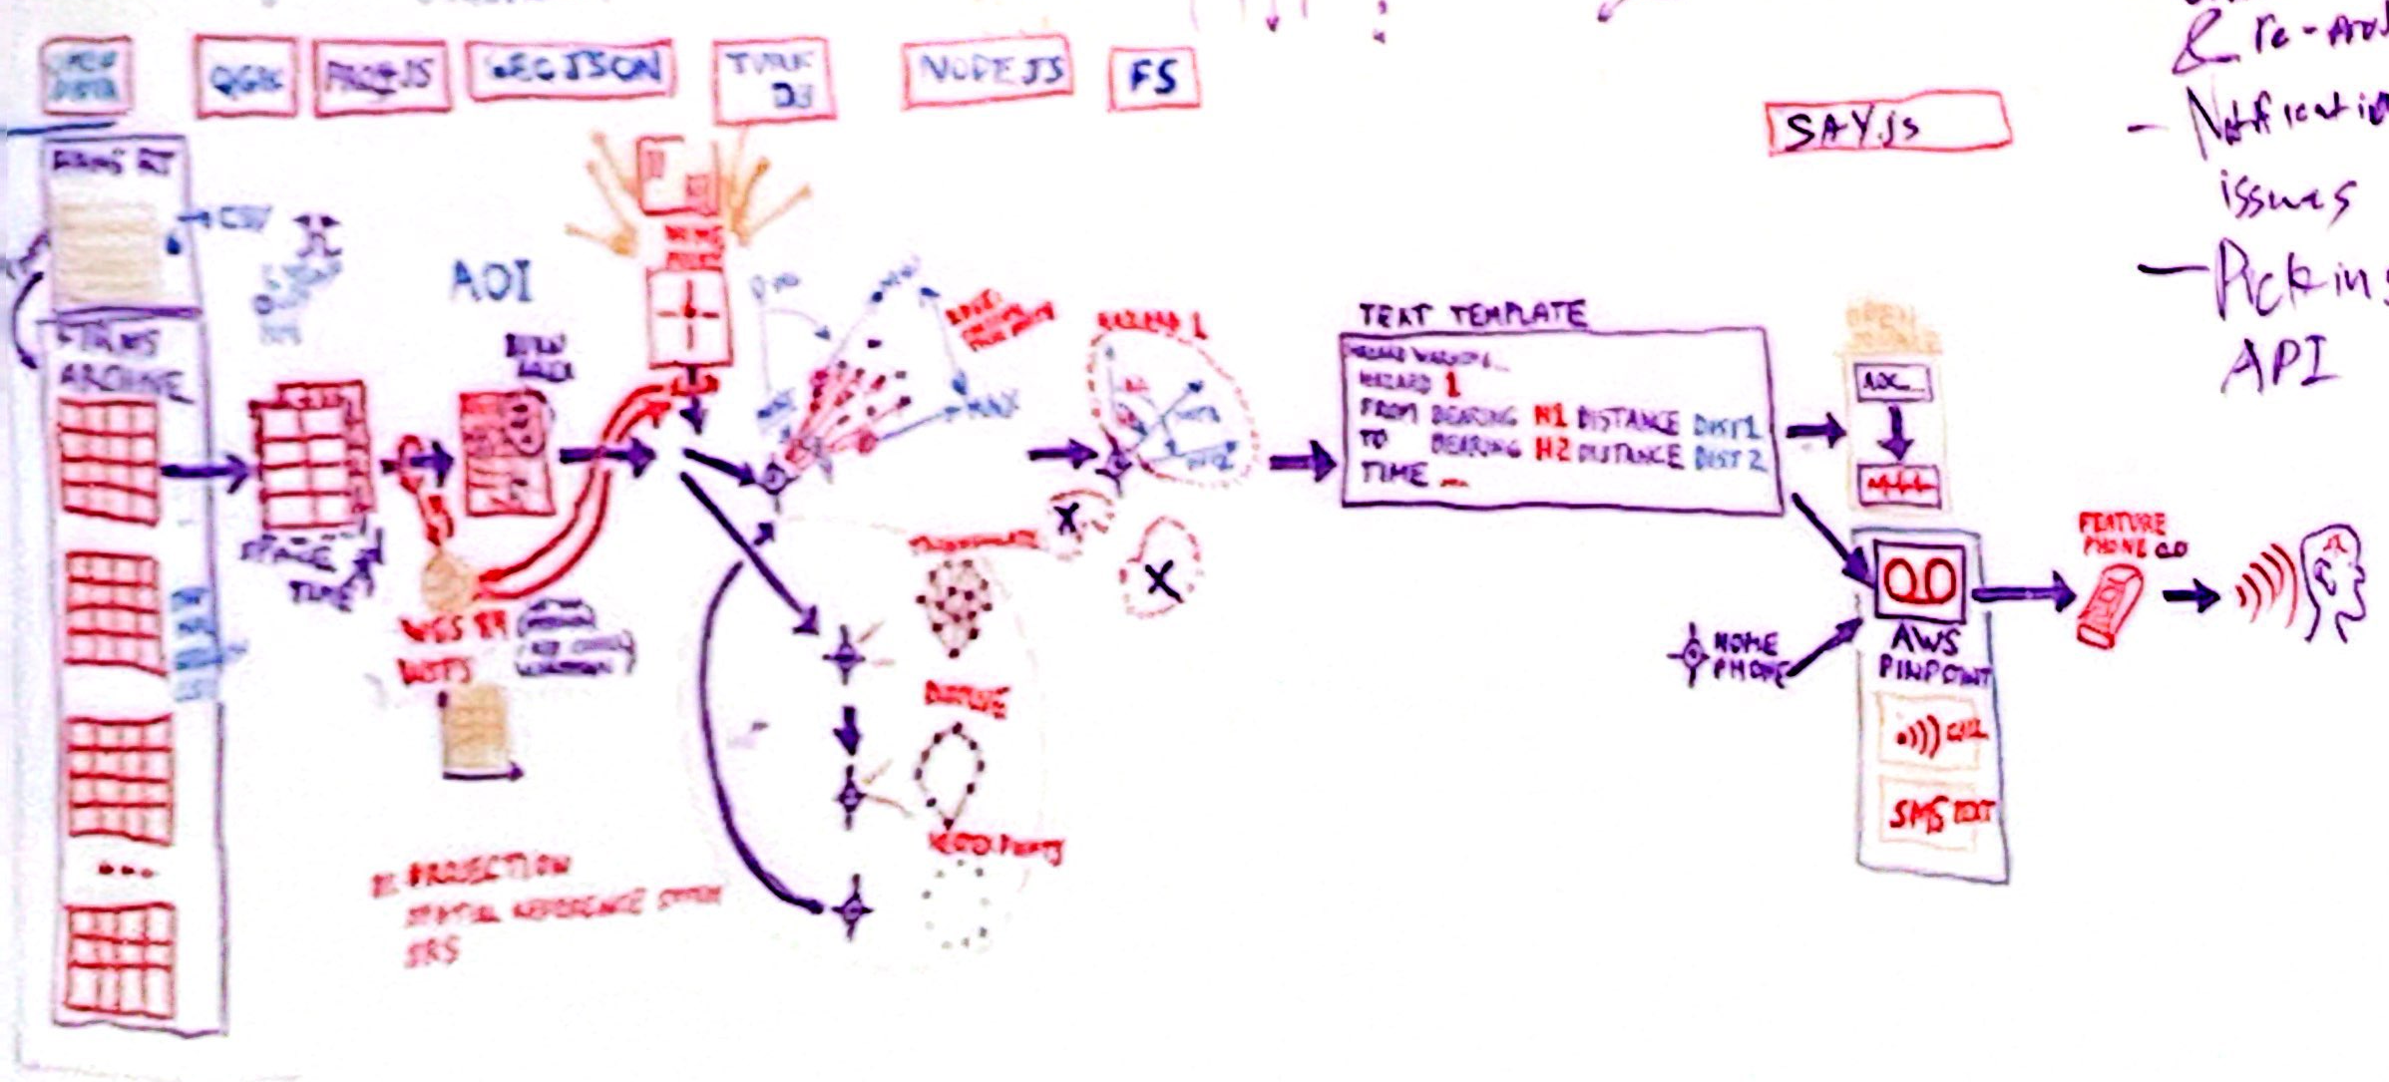
NASA FIRMS to Voicemail Pipeline
Open Source Projects
QGIS, PROJ4JS, GeoJSON
Turf, Node, Fs, Say.js
Open Data
NASA FIRMS LANCE
USGS National Map
WaDOT, WSDNR
,
NASA Space Apps 2023 Seattle, Wildfire Management

Slide 5
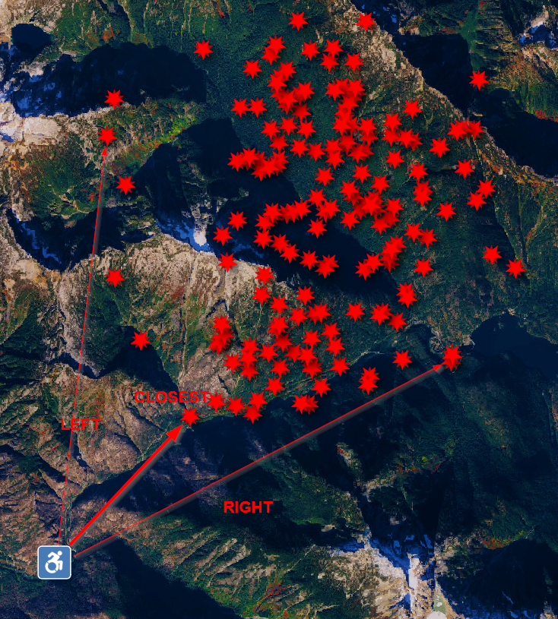

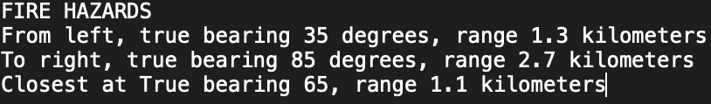
Learning Curve
Technical Challenges
Coordinate Reference Systems & Reprojection
Voicemail, SMS, and Notification Systems
Picking appropriate APIs
AWS Admin and Sandbox
How?
Relation to Field of View, Depth of Field

Slide 6
Going Forward
Funds
Revenue Markets
Outdoor recreation – Hunters, Fisherman
Rural workers – Ranchers, Farmers, Loggers
Remote Property Owners
Non-Profit Markets
Emergency Services – Volunteer Fire Departments
Social Workers, Low income property owners
Rural Governments
Business Plan:
Foundation and Open source Community
NASA Space Apps 2023 Seattle, Wildfire Management

Slide 7
LoLa-LoLa Hazard warnings at the Edge
Thank You!!!
Team Stemmies++
Michael Patrick – Concept and Design
Akash Savitala – Computation
Vignesh Srinivasan – Code and Voice
NASA Space Apps 2023 Seattle, Wildfire Management

